Slide 1
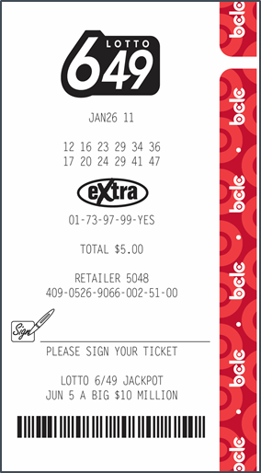
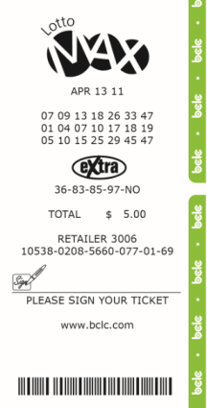
Lotto Express Tickets Features
Lotto Express is an in-lane method of selling lottery tickets via a Lotto Express lottery terminal available through Grocery Retailers such as Loblaw’s, Overwaitea Food Group, Sobeys, Country Grocer and 49th Parallel.
Lotto Express Ticket Features
Currently, Lotto Express terminals print Lotto 6/49 and Lotto Max tickets only.
Lotto Express tickets are similar to tickets printed from the Altura lottery terminal, however, there are slight differences:
Lotto 6/49 and Lotto Max tickets purchased through Lotto Express are narrower by a few millimeters and are printed on a thinner thermal paper than tickets printed from Altura lottery terminals.
Validation at Retail
Please accept Lotto 6/49 and Lotto Max tickets sold through a Lotto Express retailer for Validation.
Tickets printed from the Lotto Express Terminal should be validated and paid out exactly the same as per standard validation and prize payout procedures.
If you have questions regarding validating or paying out Lotto Express tickets, please contact Lottery Support Hotline at 1-800-667-1649
Lotto ticket printed through an Altura/lottery terminal.
Lotto ticket printed through a Lotto Express terminal

